Slide 1
Document Engineering-Custom E books
Under the Guidance of,
Prof . Chandrashekar R
Eashwar V (MT2011041) Anil Kumar (MT2011165)
Nishanth T S (MT2011092) Vyshak GV (MT2011174)

Slide 2
Introduction
Document engineering refers to the design of a document to meet very specific requirements for Clarity. By clarity we mean the documents make complete sense to the users and the applications that need them.

Slide 3
Brief description of the project
Using the principles of document engineering, to build an authoring tool that creates an interactive document that allows the user to interact with the computer. Apart from interactions, the document can comprise of text, images, videos and music.
Secondly, to build a reader tool that can read the document.

Slide 4
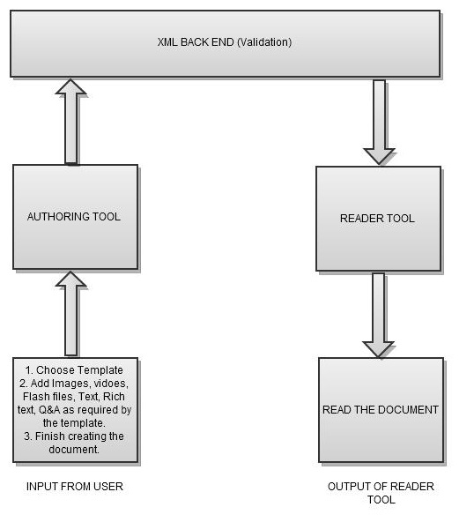
Architecture diagram

Slide 5
Work done -Authoring tool
1. Created an authoring tool that takes text, audio, video, images,rich-text and flash as input from the user.
2. Based on the input taken, an xml document is created by the tool, where apart from text which is stored as it is, meta-data corresponding to other inputs are stored.
3. All the data along with the XML document is stored in a folder by the name given by the user initially.
4. Apart from creating the folder, the authoring tool also zips the folder, so that the complete package can be read by the reader tool.

Slide 6
Work done -Authoring tool cont...
5. In the authoring tool added four different templates for the author to choose from.
5. Depending on the template choosen the tool displays only those input features for the author to enter the elements.
6. Created a basic quiz form as one of the interactions and it is a part of some of the templates.

Slide 7
Work done -Reader tool
1. The reader tool unzips the selected zipped file and places the folder in the desired reader-tool folder.
2. Apart from unzipping the folder, the reader tool automatically creates a prod.xsd file and places it in the unzipped folder.
3. The reader tool validates the XML file with the prod.xsd file, only if the validation is successful the document is displayed.

Slide 8
Work done -Reader tool cont..
4. If the validation is unsuccessful, then a pop up is shown that the document is invalid or it is corrupt and the tool doesn't display the document.
5. In the XML file there is an entry that stores the template number.Depending on the template number, the data is displayed in the desired format.

Slide 9
Architecture methodology explanation-1(SE point of view)
Model Followed: Prototyping + Component Based Development
Work begins with gathering whatever understanding is available with developers and customers regarding requirements.
A quick design is done and prototype is done.
Components selected for reuse.
Components are reviewed and modified to ensure that they properly fit into the architecture of the system.
Full system is created form various sub-systems grouped together which itself is an agglomeration of various components.
lk

Slide 10
Architecture methodology explanation-2(SE point of view)
Prototyping:
Around 8 versions of our software:
Customer
Interactions
Build/revise
mock-up
Customer
test drives
mock-up

Slide 11
Individual contribution of each member
Eashwar: Development Richtext editor for the authoring tool, worked on development of authoring tool and reader tool for template 1.
Nishanth : Worked on video and image insertion and worked on development of authoring tool and reader tool for template 2.
Anil: Worked on Quiz validation,exe creation for authoring and reader tool and worked on development of authoring tool and reader tool for template 3.
Vyshak: Worked on creation of XML schema and validation,worked on flash insertion and worked on development of authoring and reader tool for template 4.

Slide 12
links
TIMESHEET:
https://docs.google.com/spreadsheet/ccc?key=0AlzrI3gMiw2YdEk1eDVvSGdlSk12YkxSa3I1ZTdaSGc
CODE:
https://github.com/eashwar4/DocumentEngineering
MONTHLY ANALYSIS:
https://docs.google.com/spreadsheet/ccc?key=0AlzrI3gMiw2YdFFsR0IwYWdjdktzVkh6bXdERXMwVVE
TEST CASE DOCUMENT:
..\final documentation\TestCaseDoc.xls

